Slide 1
EV Remote Internship Project Report
Created by
Bharath, Simulation Engineer
Project Name
Nissan Leaf
Case Studies: FTP-75/MENDC/WLTP Drive Cycle

Slide 2
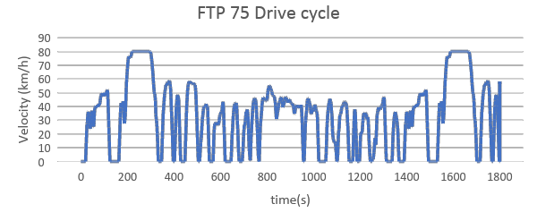
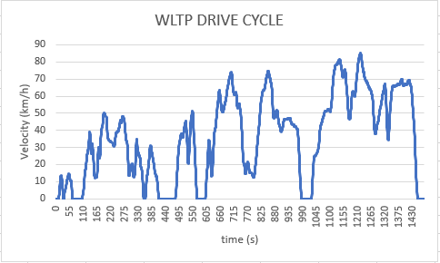
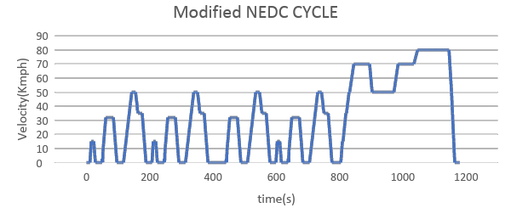
Drive Cycles
FTP-75 Drive Cycle
WLTP Drive Cycle
NEDC Drive Cycle
This Simulation was performed with respect to drive cycle
Distance
FTP-75 = 17.5 km
MNEDC = 10.274 km
WLTP = 14.664 km

Slide 3
Model Inputs
Sl No | Parameter | Value | Units
1 | Chassis
2 | Coefficient of rolling resistance | 0.015
3 | Mass of Vehicle | 1630.665 | Kg
4 | Mass of Driver | 80 | Kg
5 | Gravity constant | 9.81 | m/s
6 | Grade Angle | 0 | degree
7 | Velocity | From the FTP Drive Cycle data | Kmph
8 | Frontal Area | 3.8056 | m^2
9 | Air Density | 1.225 | Kg/m^3
10 | Drag Coefficient | 0.28
11 | Radius of wheel | 0.2032 | m
12 | Transmission
13 | Gear Ratio | 7.9377
14 | Transmission Efficiency | 89 | %
14 | Motor
15 | Motor Efficiency | 92 | %
16 | Battery
17 | Motor Controller Efficiency | 90 | %
18 | Battery Capacity | 24000 | Wh
19 | Battery Voltage | 364.8 | V
20 | FTP drive cycle distance | 17.5 | Km
21 | Battery Initial SOC | 100 | %
22 | Drive Cycle time or Simulation time | 1875 | s
23 | Cell
24 | Cell Voltage | 3.8 | V
25 | Cell Capacity | 33.1 | Ah

Slide 4
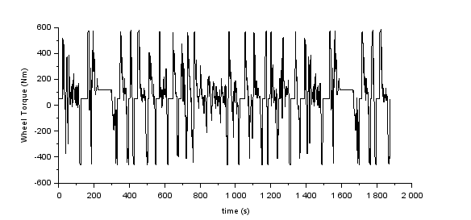
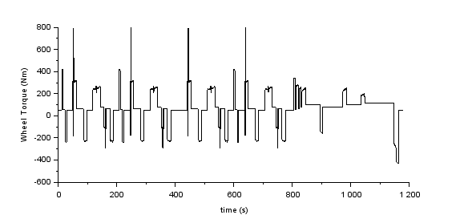
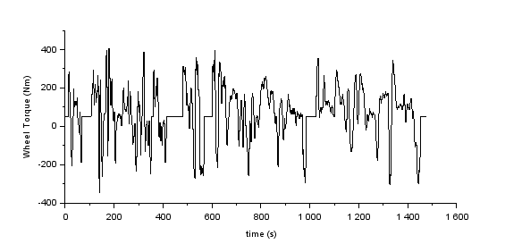
Wheel Torque for different Drive Cycles
FTP-75 Drive Cycle
MNEDC Drive Cycle
WLTP Drive Cycle
Nominal Torque = 400 | Nominal Torque = 400 | Nominal Torque = 350
Average Nominal Torque = 350 to 400 Nm

Slide 5
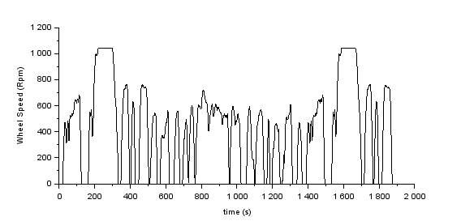
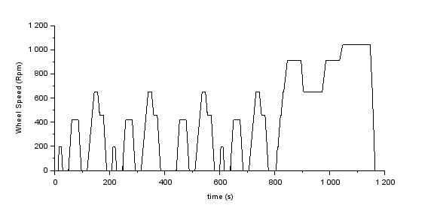
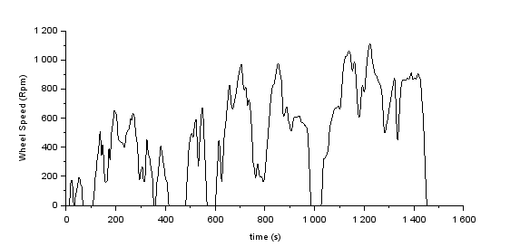
Wheel Speed for different Drive Cycles
FTP-75 Drive Cycle
MNEDC Drive Cycle
WLTP Drive Cycle
Wheel Speed = 1050 | Wheel Speed = 1050 | Wheel Speed = 1100

Slide 6
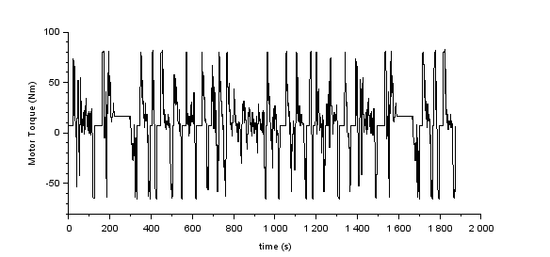
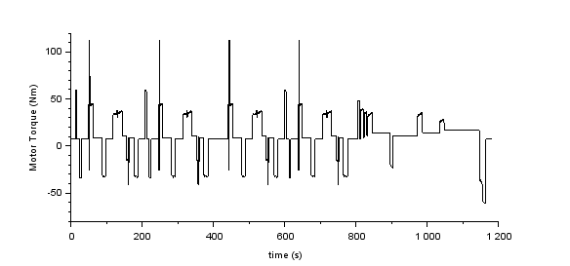
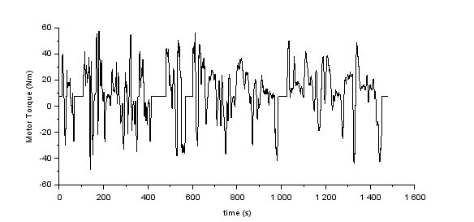
Motor Torque for different Drive Cycles
FTP-75 Drive Cycle
MNEDC Drive Cycle
WLTP Drive Cycle
Nominal Torque = 80 | Nominal Torque = 110 | Nominal Torque = 58
Average Nominal Torque = 58 to 110 Nm
Note: Maximum acceleration for the drive cycle is 2.15 m/s^2
Maximum Acceleration for the Acceleration test is 5.3 m/s^2

Slide 7
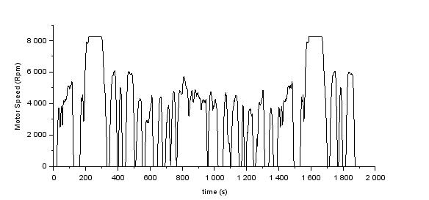
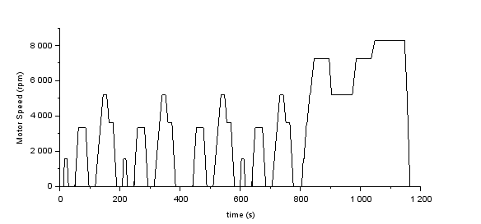
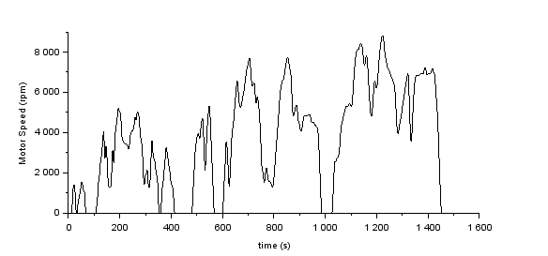
Motor Speed for different Drive Cycles
FTP-75 Drive Cycle
MNEDC Drive Cycle
WLTP Drive Cycle
Motor Speed = 8100 | Motor Speed = 8100 | Motor Speed = 8300
Motor Speed (for 80 kmph) = 8300 rpm (for 91 Kmph, Motor Speed = 9700 rpm)

Slide 8
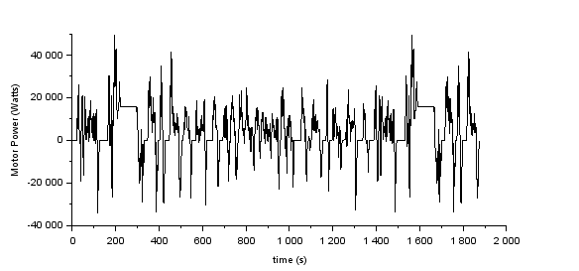
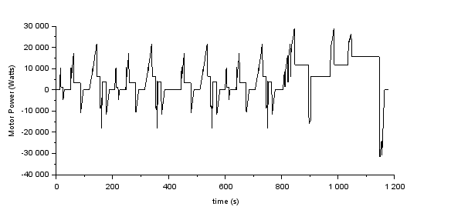
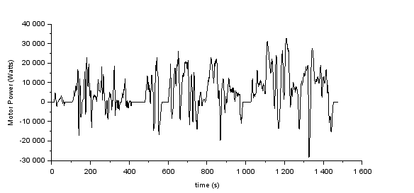
Motor Power for different Drive Cycles
FTP-75 Drive Cycle
MNEDC Drive Cycle
WLTP Drive Cycle
Nominal Power = 23000 | Nominal Power = 21000 | Nominal Power = 26000
Average Motor Nominal Power = 21000 to 26000 Watts

Slide 9
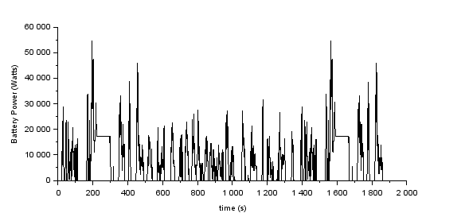
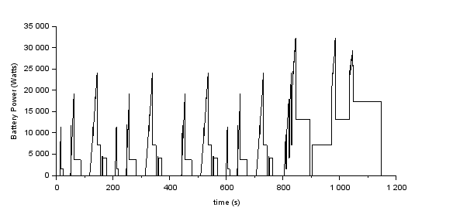
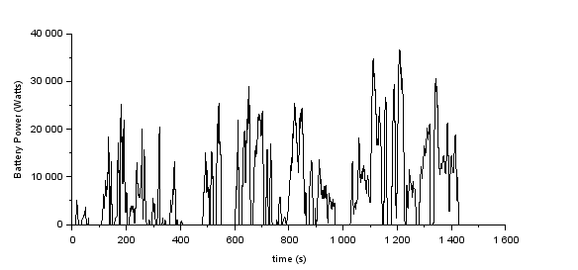
Battery Power for different Drive Cycles
FTP-75 Drive Cycle
MNEDC Drive Cycle
WLTP Drive Cycle
Nominal Power = 31000 | Nominal Power = 25000 | Nominal Power = 26000
Average Battery Nominal Power = 25000 to 31000 Watts

Slide 10
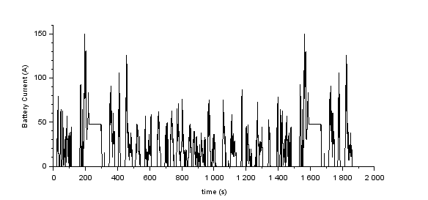
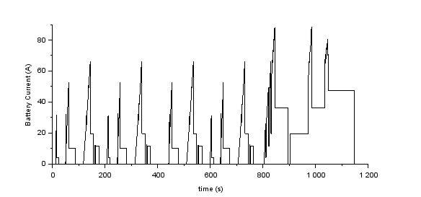
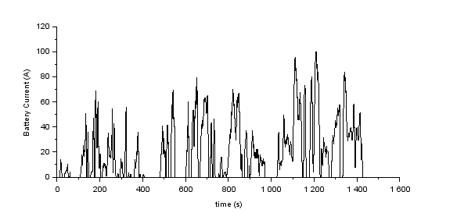
Battery Current for different Drive Cycles
FTP-75 Drive Cycle
MNEDC Drive Cycle
WLTP Drive Cycle
Nominal Current = 75 | Nominal Current = 63 | Nominal Current = 73
Average Battery Nominal Current = 63 to 75 A

Slide 11
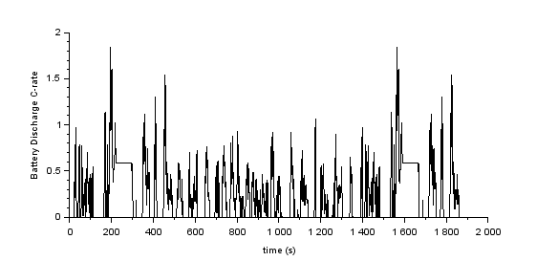

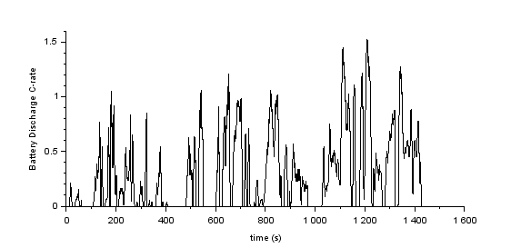
Battery Discharge C-rate for different Drive Cycles
FTP-75 Drive Cycle
MNEDC Drive Cycle
WLTP Drive Cycle
Nominal C-rate = 1 | Nominal C-rate = 1 | Nominal C-rate = 1.1
Average Battery Nominal C-rate = 1 to 1.1 C

Slide 12
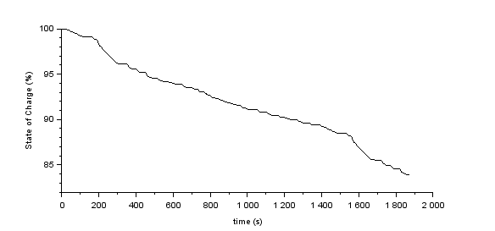
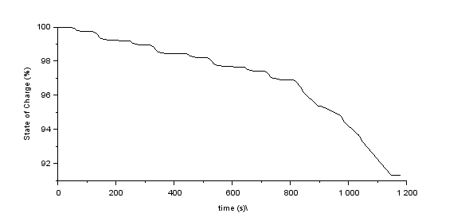
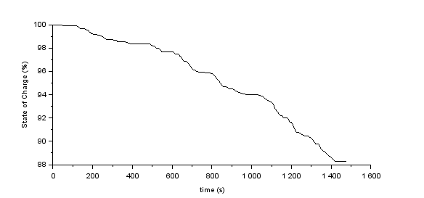
Battery SOC for different Drive Cycles
FTP-75 Drive Cycle
MNEDC Drive Cycle
WLTP Drive Cycle
SOC = 84 | SOC = 91 | SOC = 88
FTP Distance = 17.5 km | MNEDC Distance = 10.274 Km | WLTP Distance = 14.664 Km

Slide 13
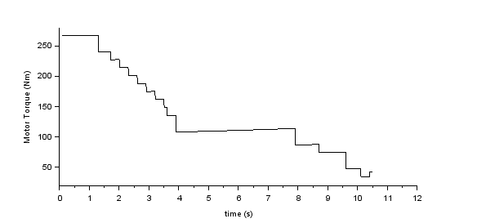
Acceleration Test
Motor Torque = 267 Nm

Slide 14
Range for different Drive Cycles
FTP 75 | MNEDC | WLTP
108.7 Km | 118.2 Km | 124.9 Km

Slide 15
Thank you
Email-id :
Mobile no.:

